Slide 1

STATUS REPORT
Team Name: Sharktooth Software
Team Members: Alexandru Cioanca, Andrew Dutton, Dustin Phan​, Gabriel Molina​, Roberto Carvalho Brigagao, Thuan Nguyen
Date: 10/10/2024

Slide 2
Metrics* Table *A software metric is a measure of software characteristics that are quantifiable or countable. Software metrics are important for many reasons, including measuring software performance, planning work items, measuring productivity, and many other uses. NOTE: Study each Metric’s definition and determine whether is is applicable to your project
 | Week 1 | Week 2 | Week 3 | Week 4 | Week 5 | Week 6 | Week 7 | Week 8 | Week N
CPI | 1 | 1 | 1 | 1 | 1 | 1 | 1 | 1
RCM (Business Application) | 10% | 10% | 10% | 10% | 10% | 10% | 30% | 30%
Error Density | N/A | N/A | N/A | N/A | N/A | 10% | 30% | 50%
MTTF | N/A | N/A | N/A | N/A | N/A | N/A | N/A | N/A
MTTR | N/A | N/A | N/A | N/A | N/A | N/A | N/A | N/A
AVAIL. | N/A | N/A | N/A | N/A | N/A | N/A | N/A | N/A
SMI | 0% | 0% | 5% | 5% | 5% | 10% | 20% | 25%

Slide 3
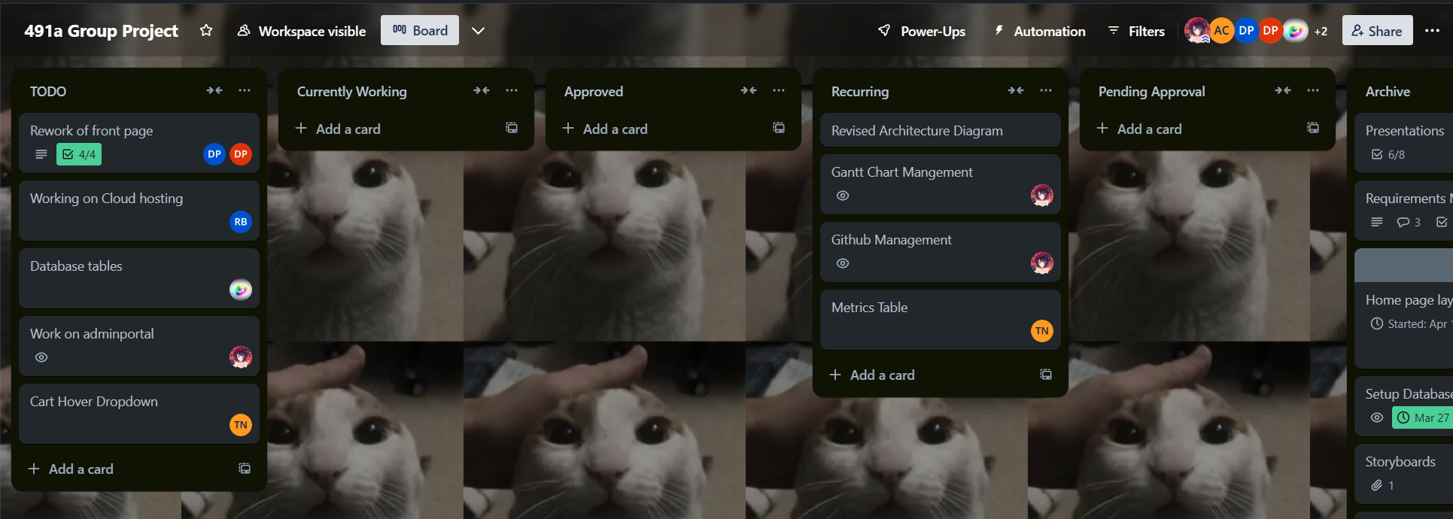
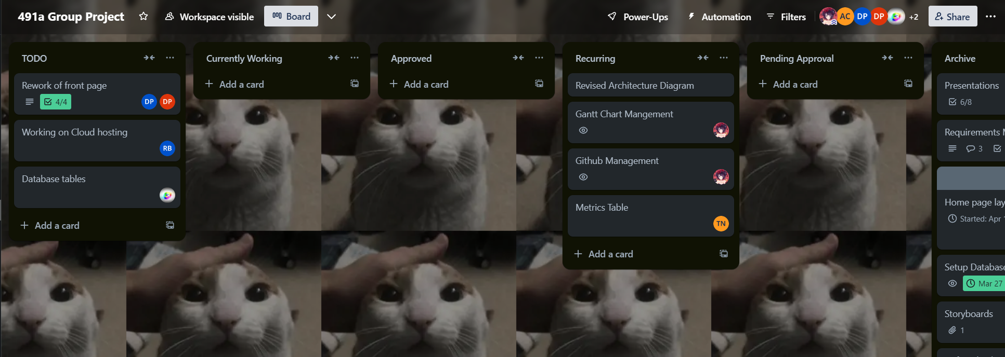
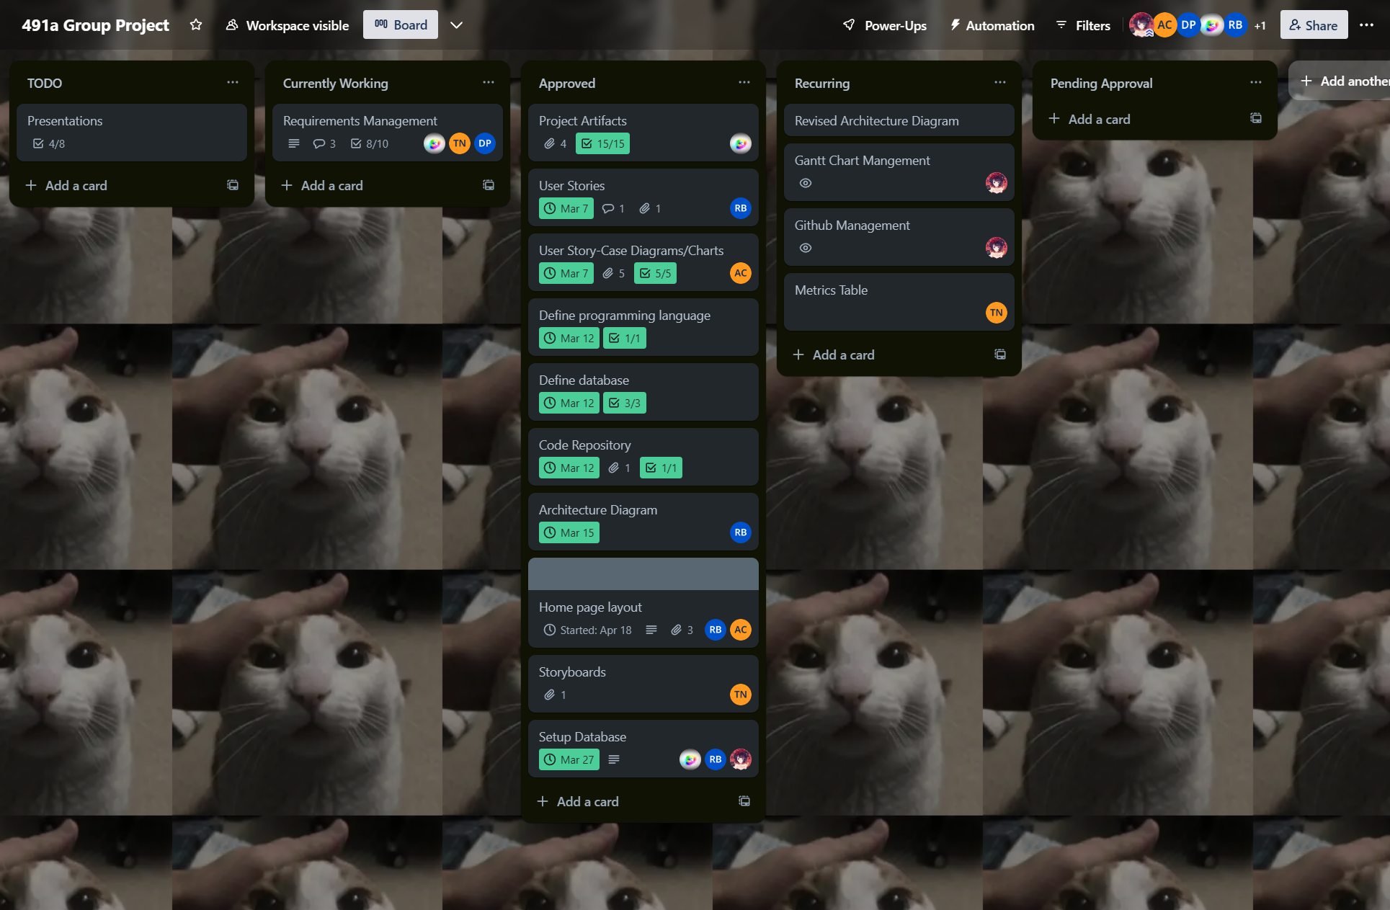
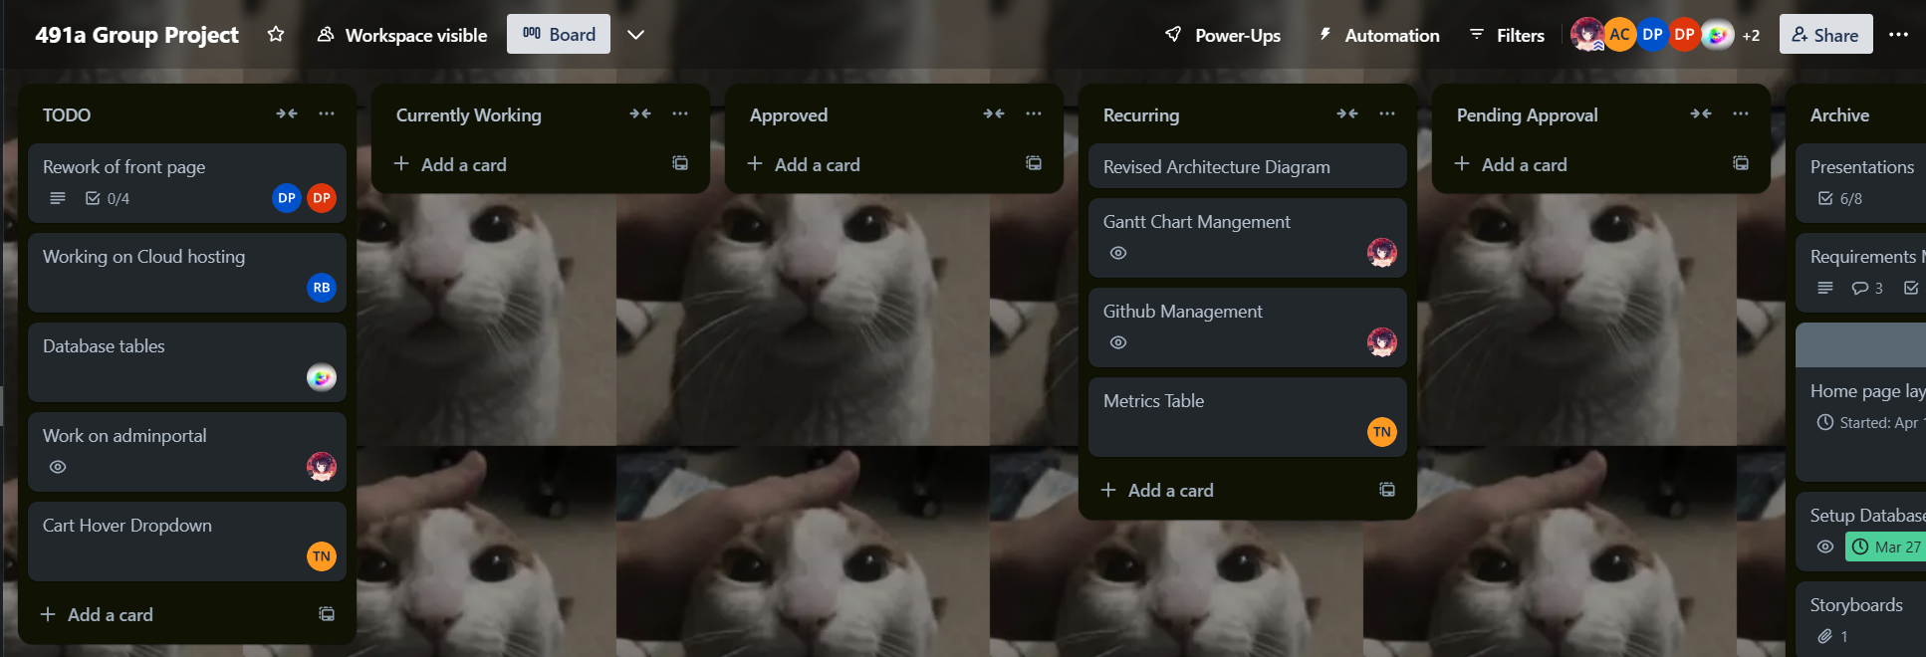
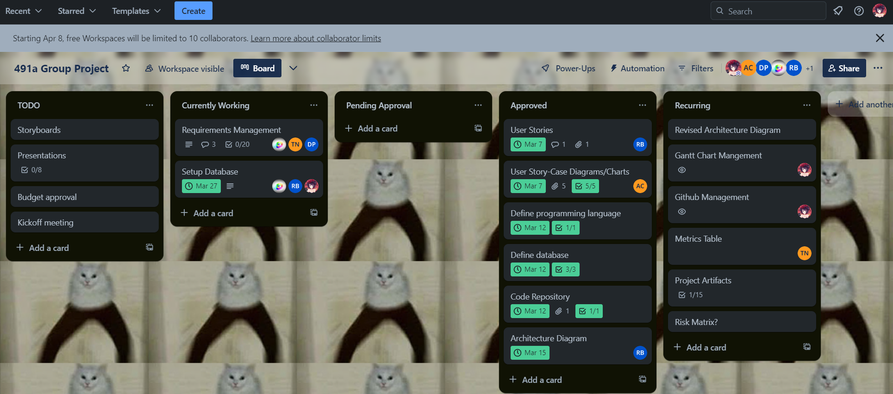
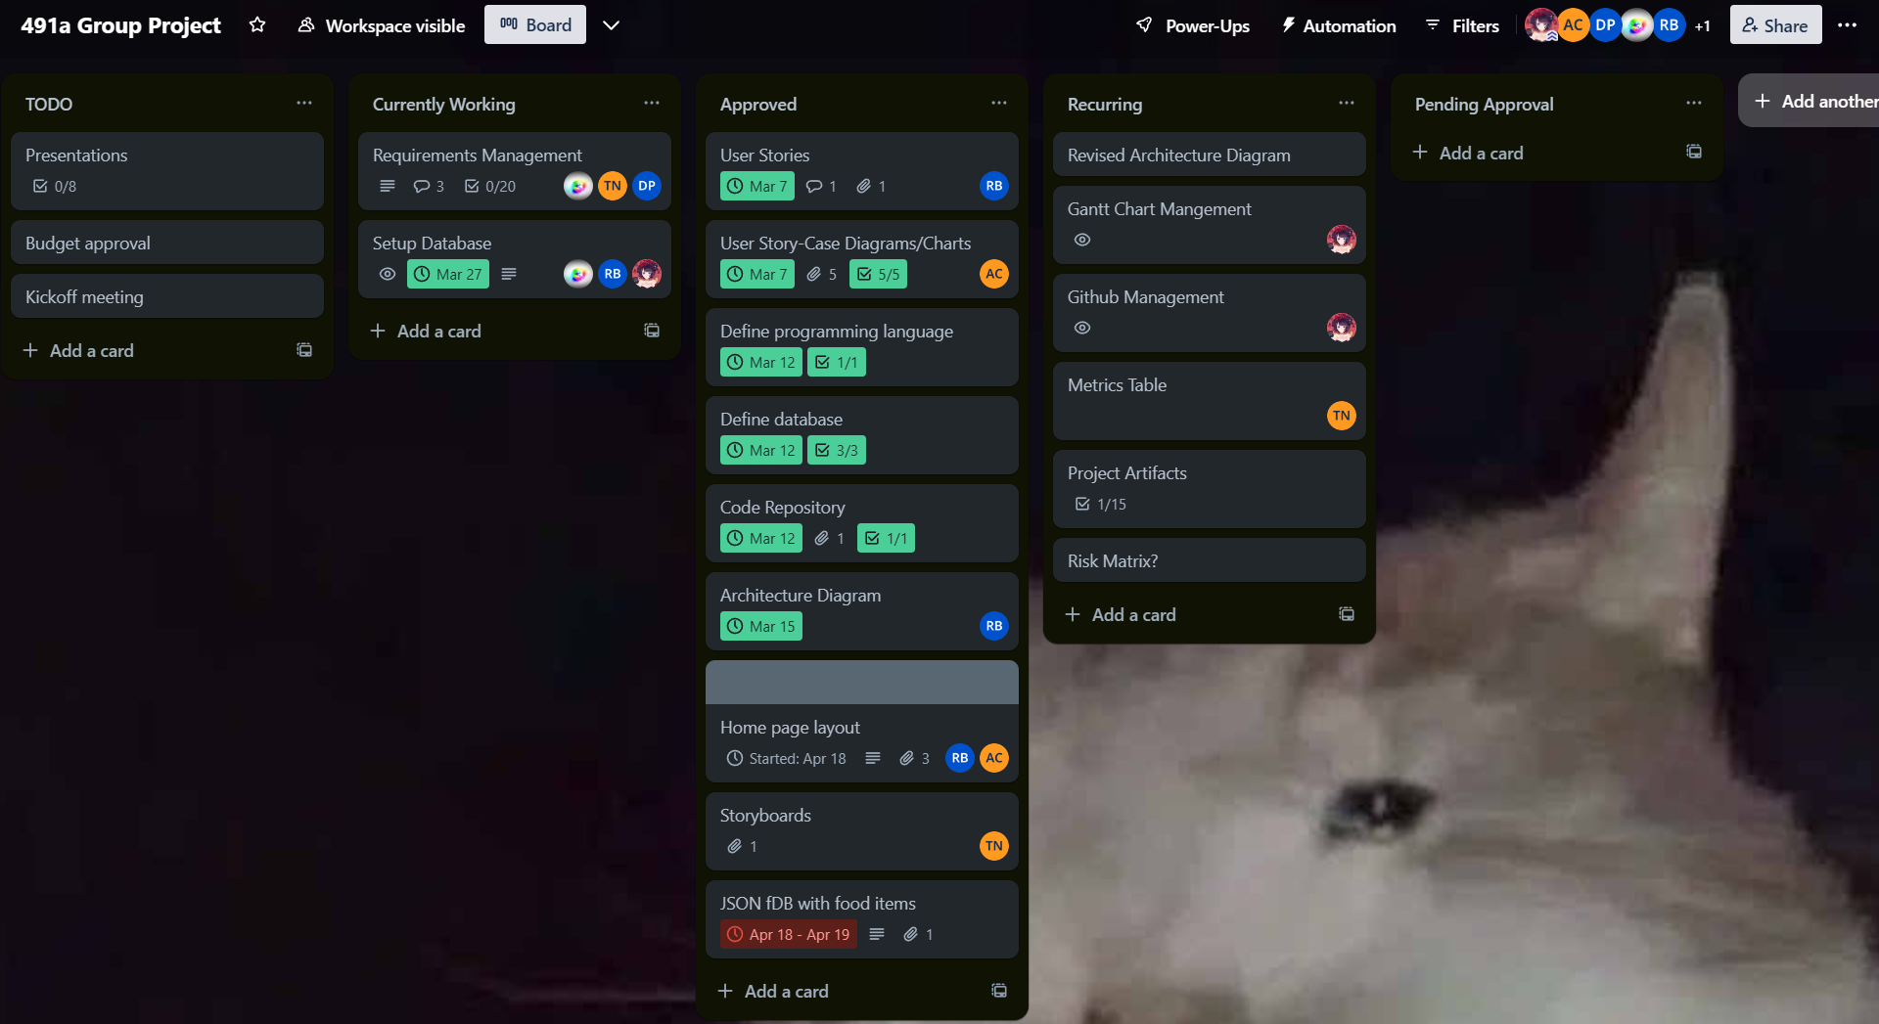
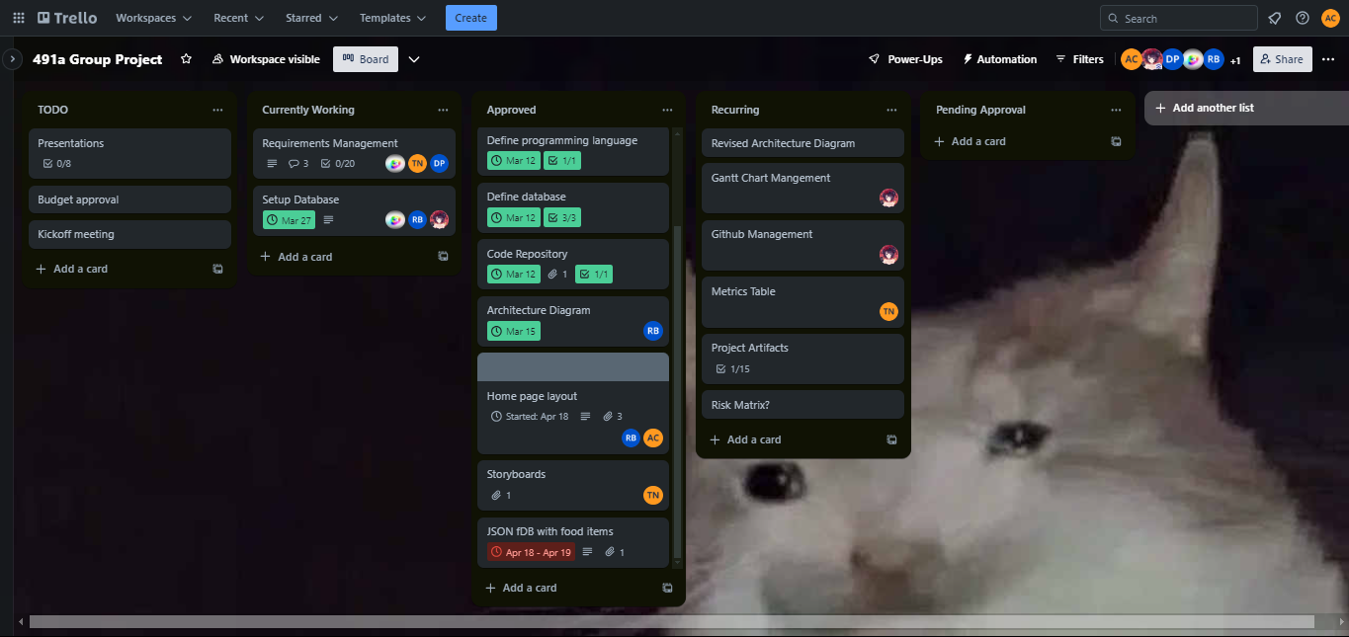
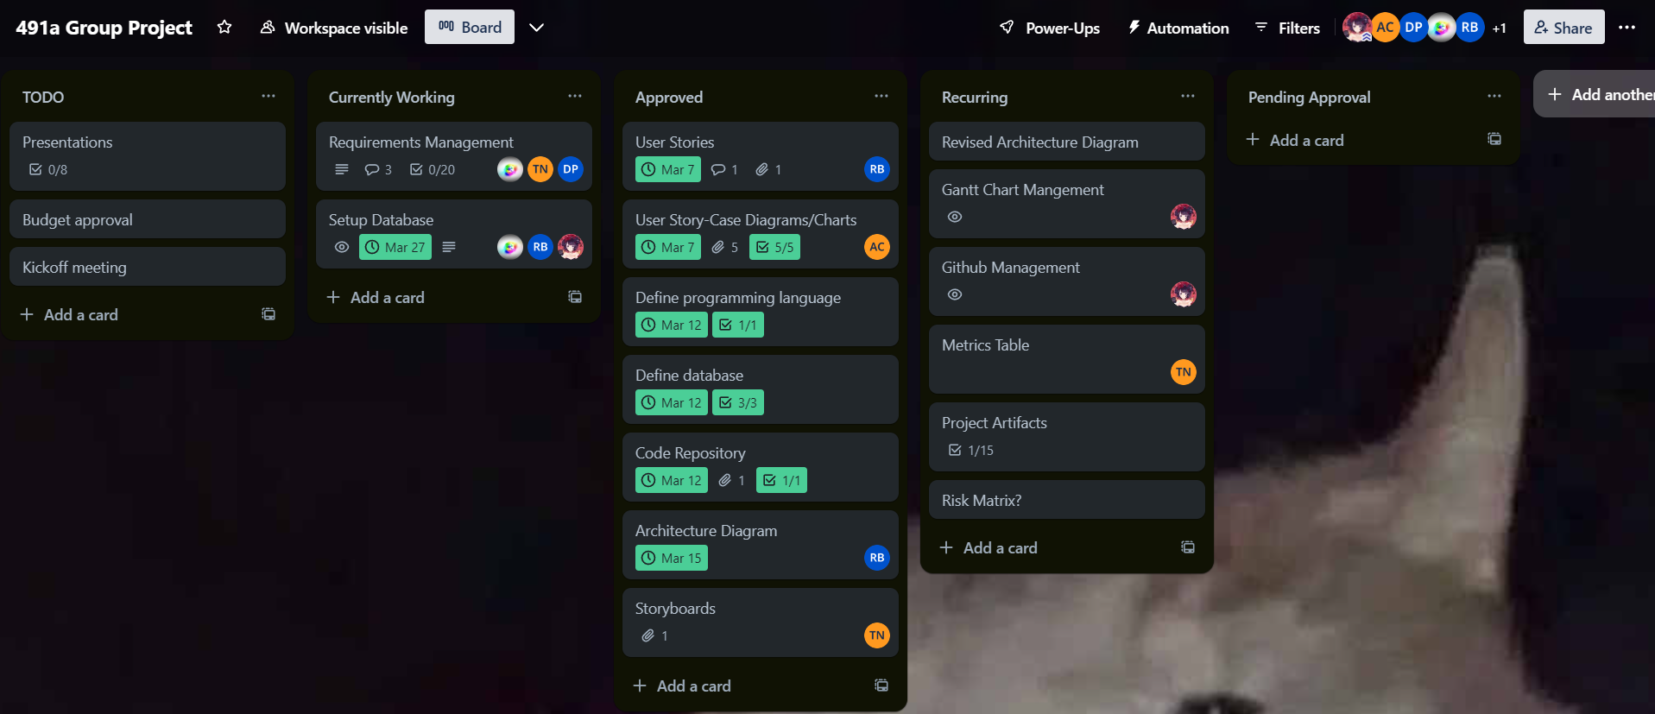
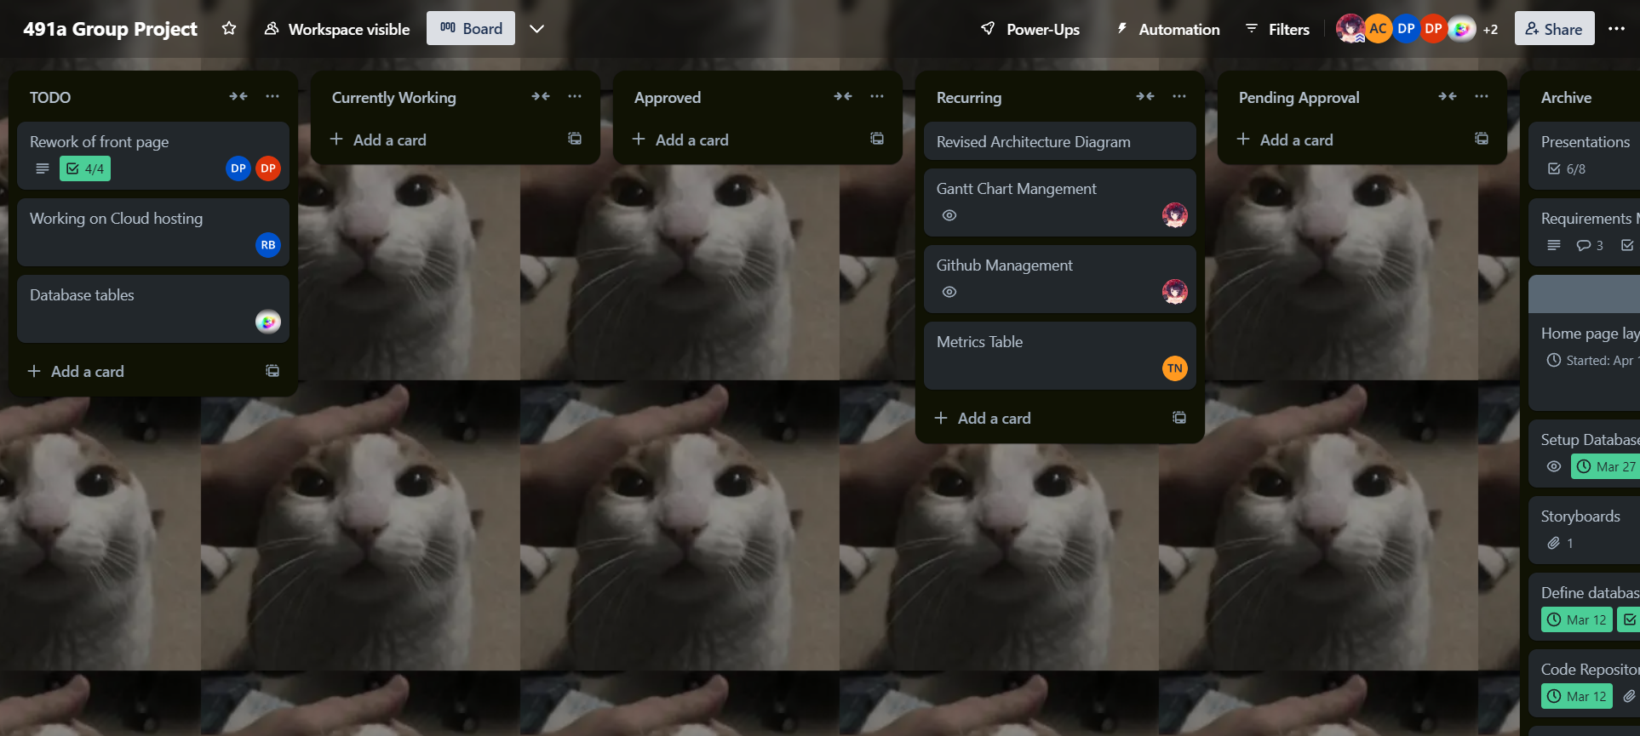
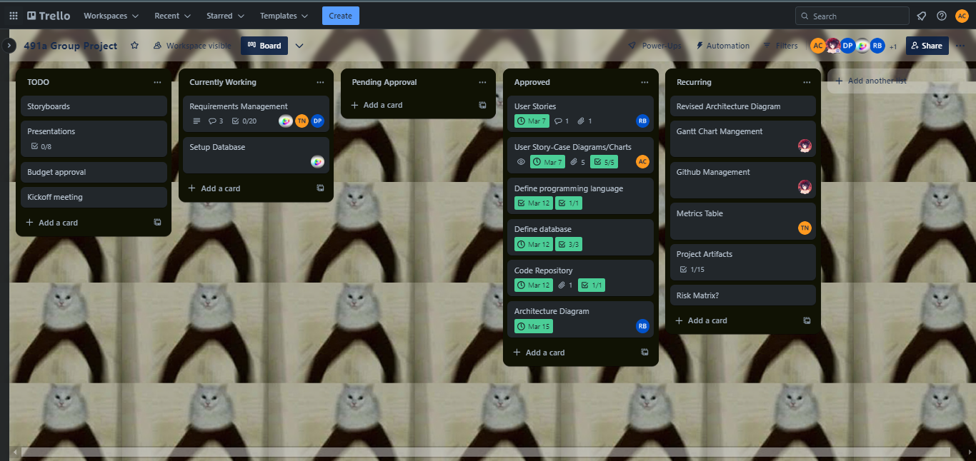
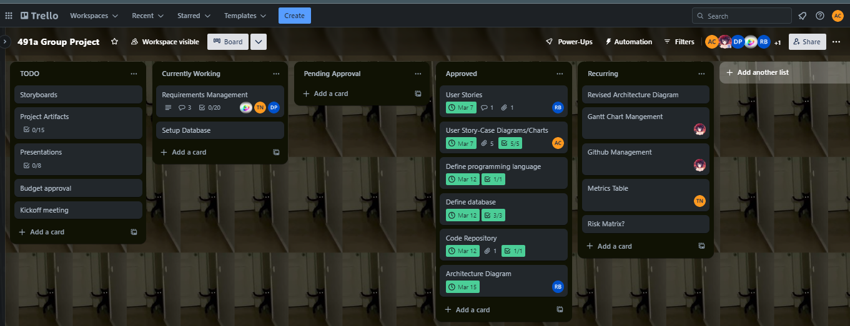
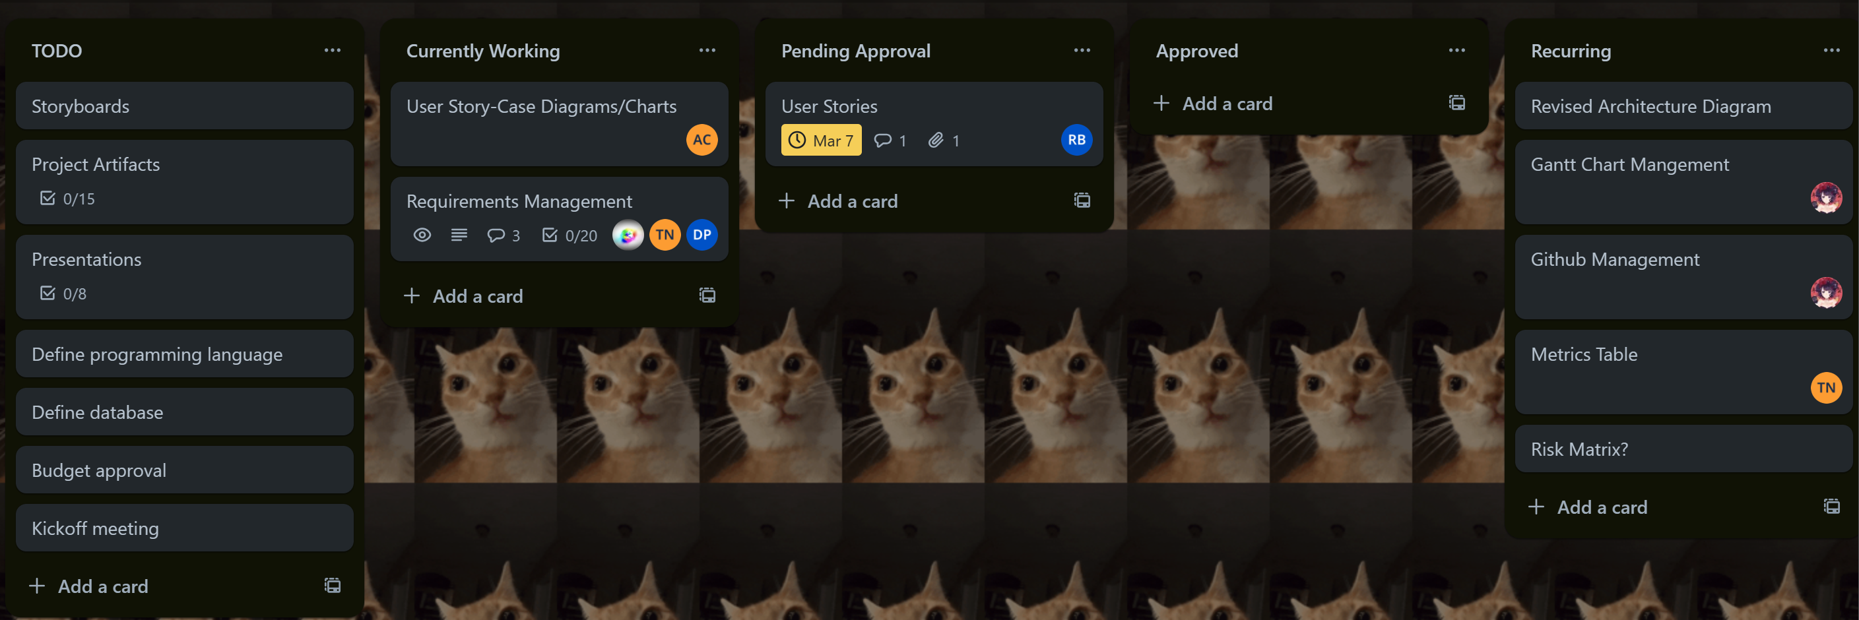
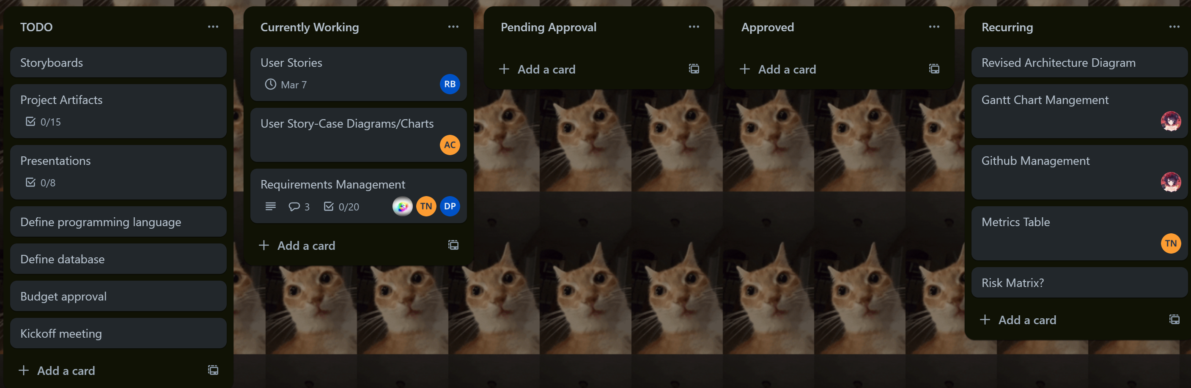
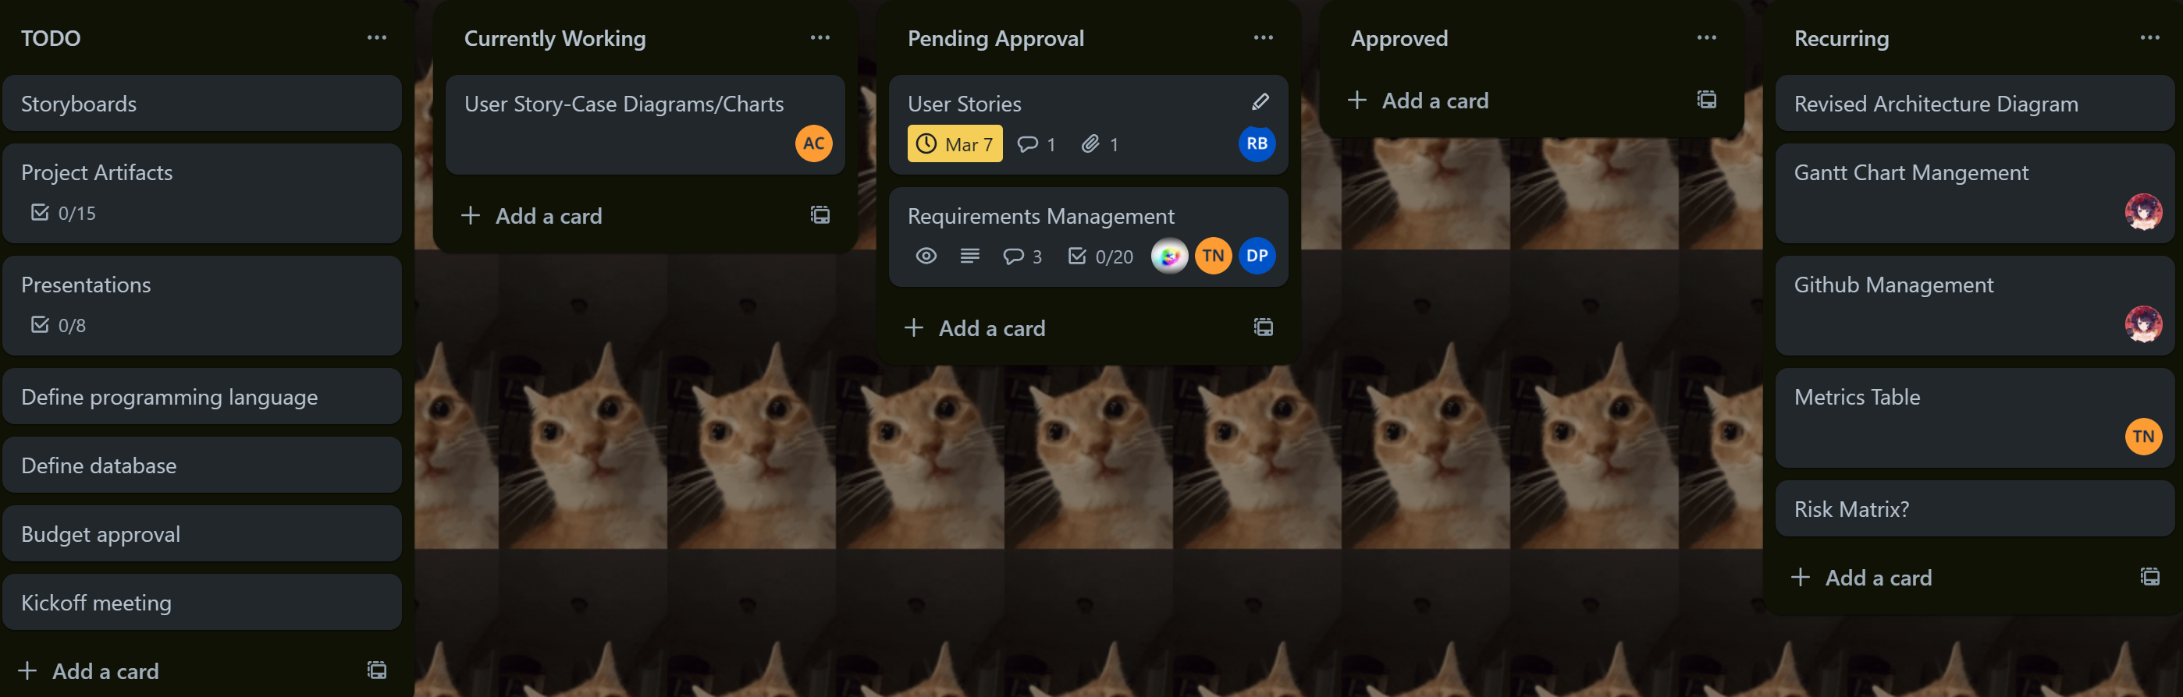
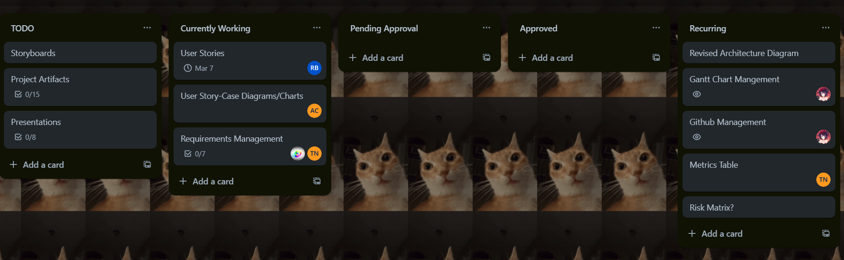
Integrated Schedule

Slide 4
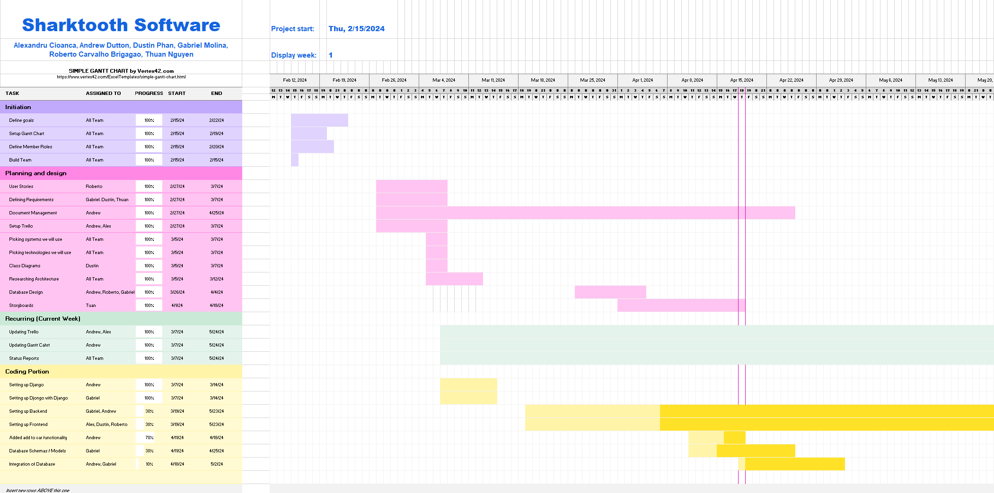
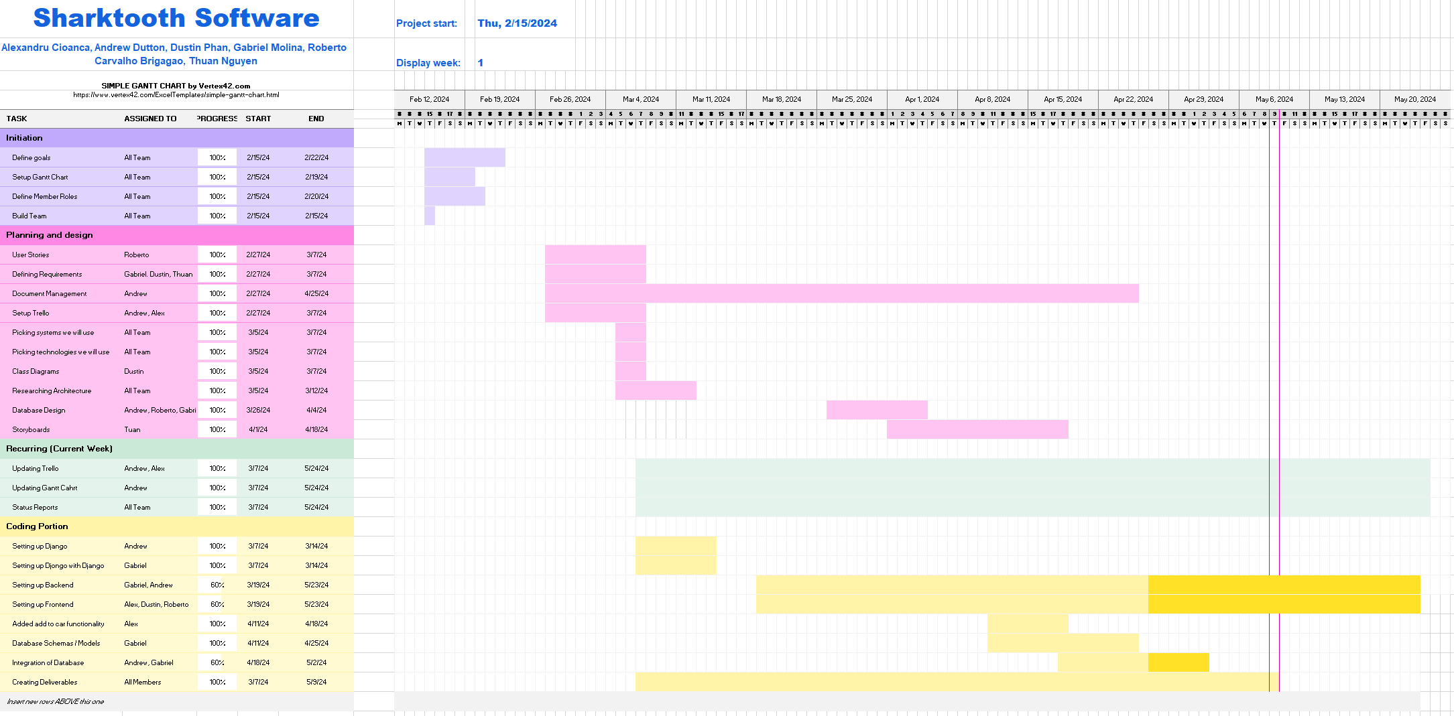
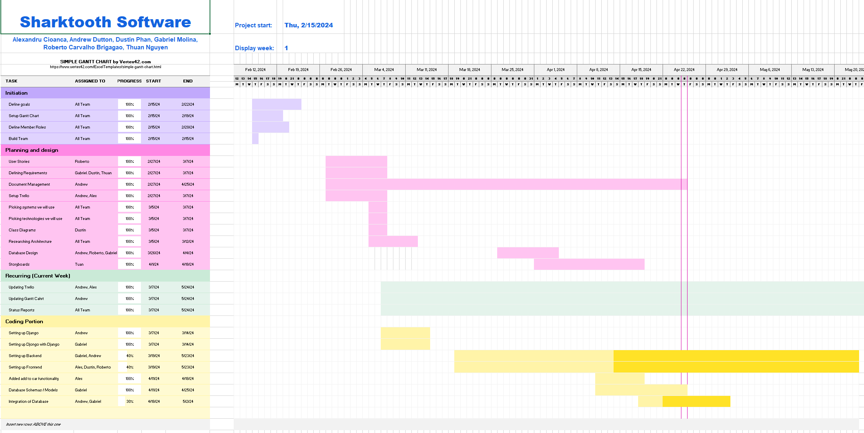
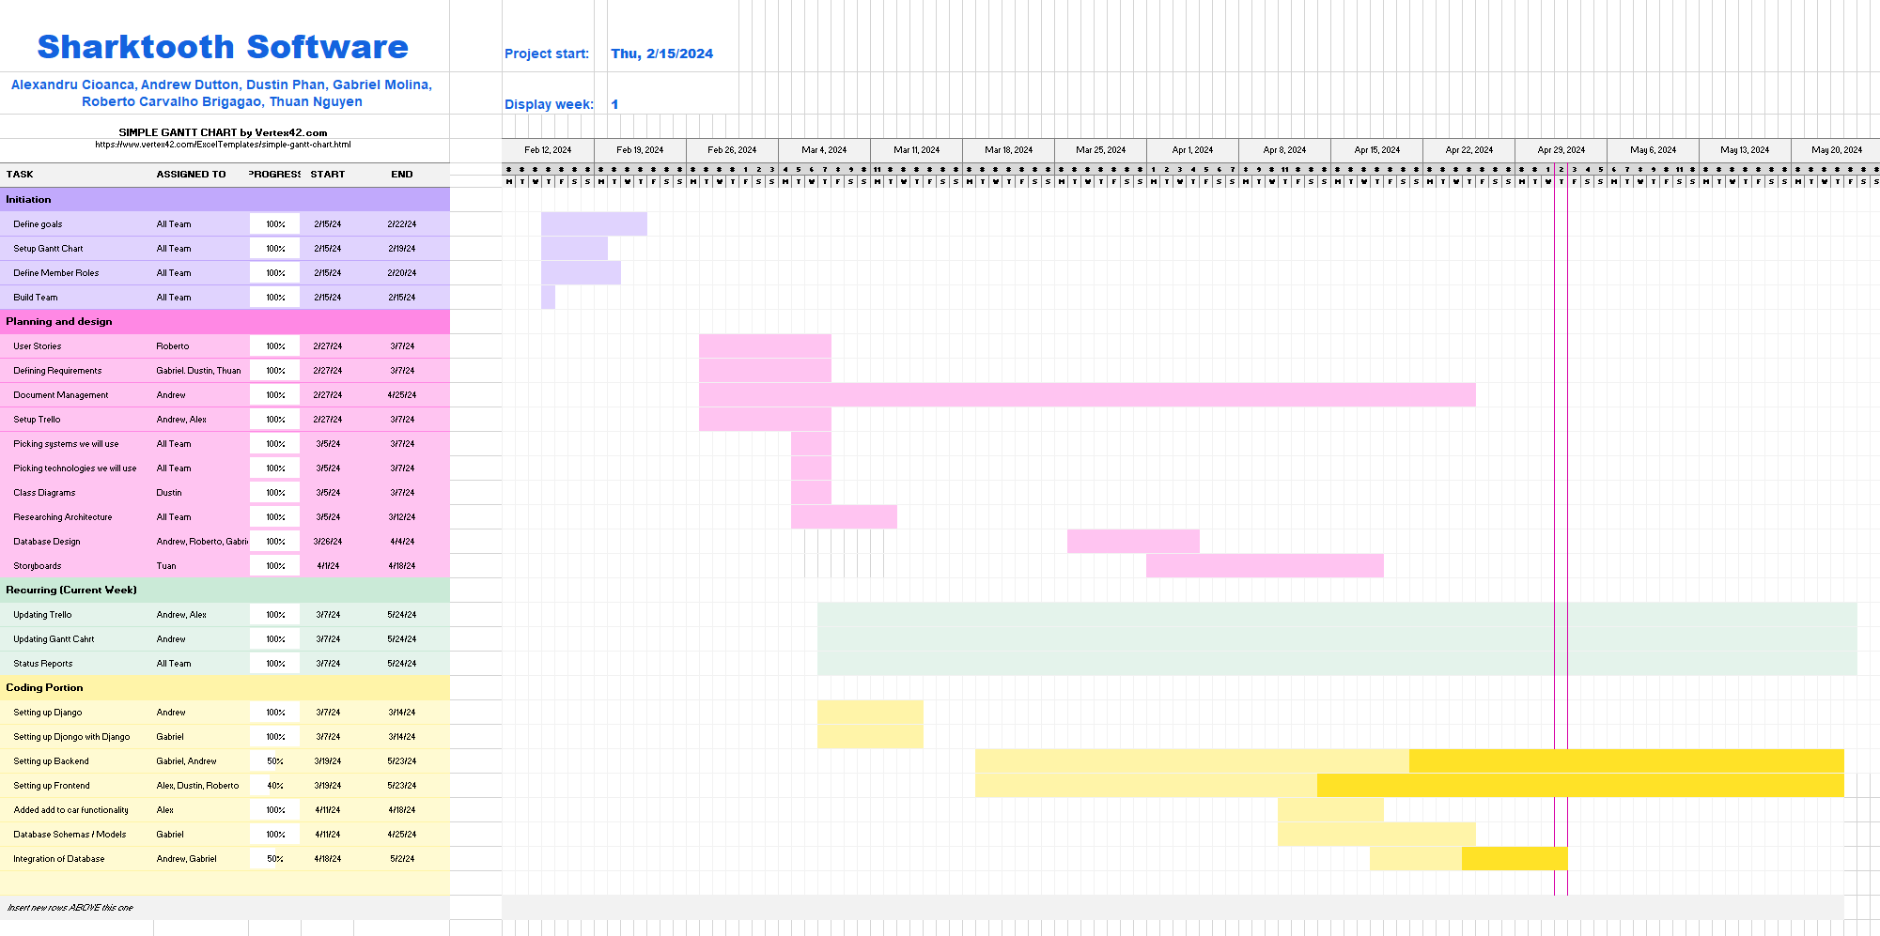
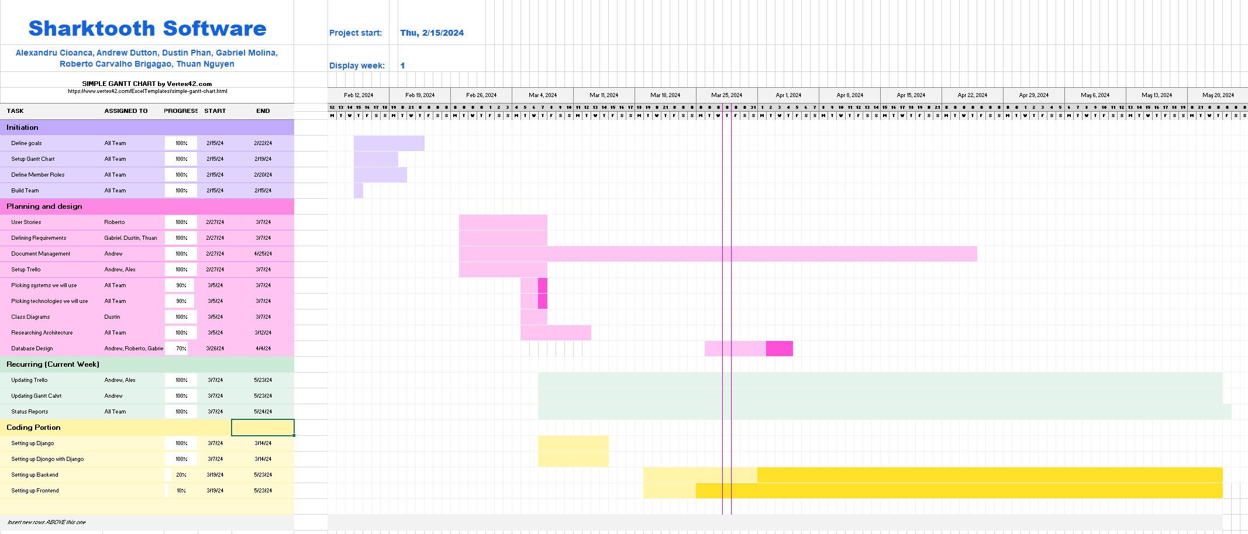
Gantt Chart 9/19/2024

Slide 5
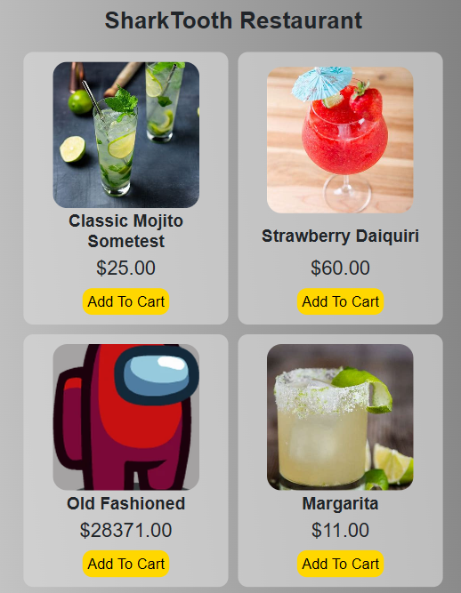
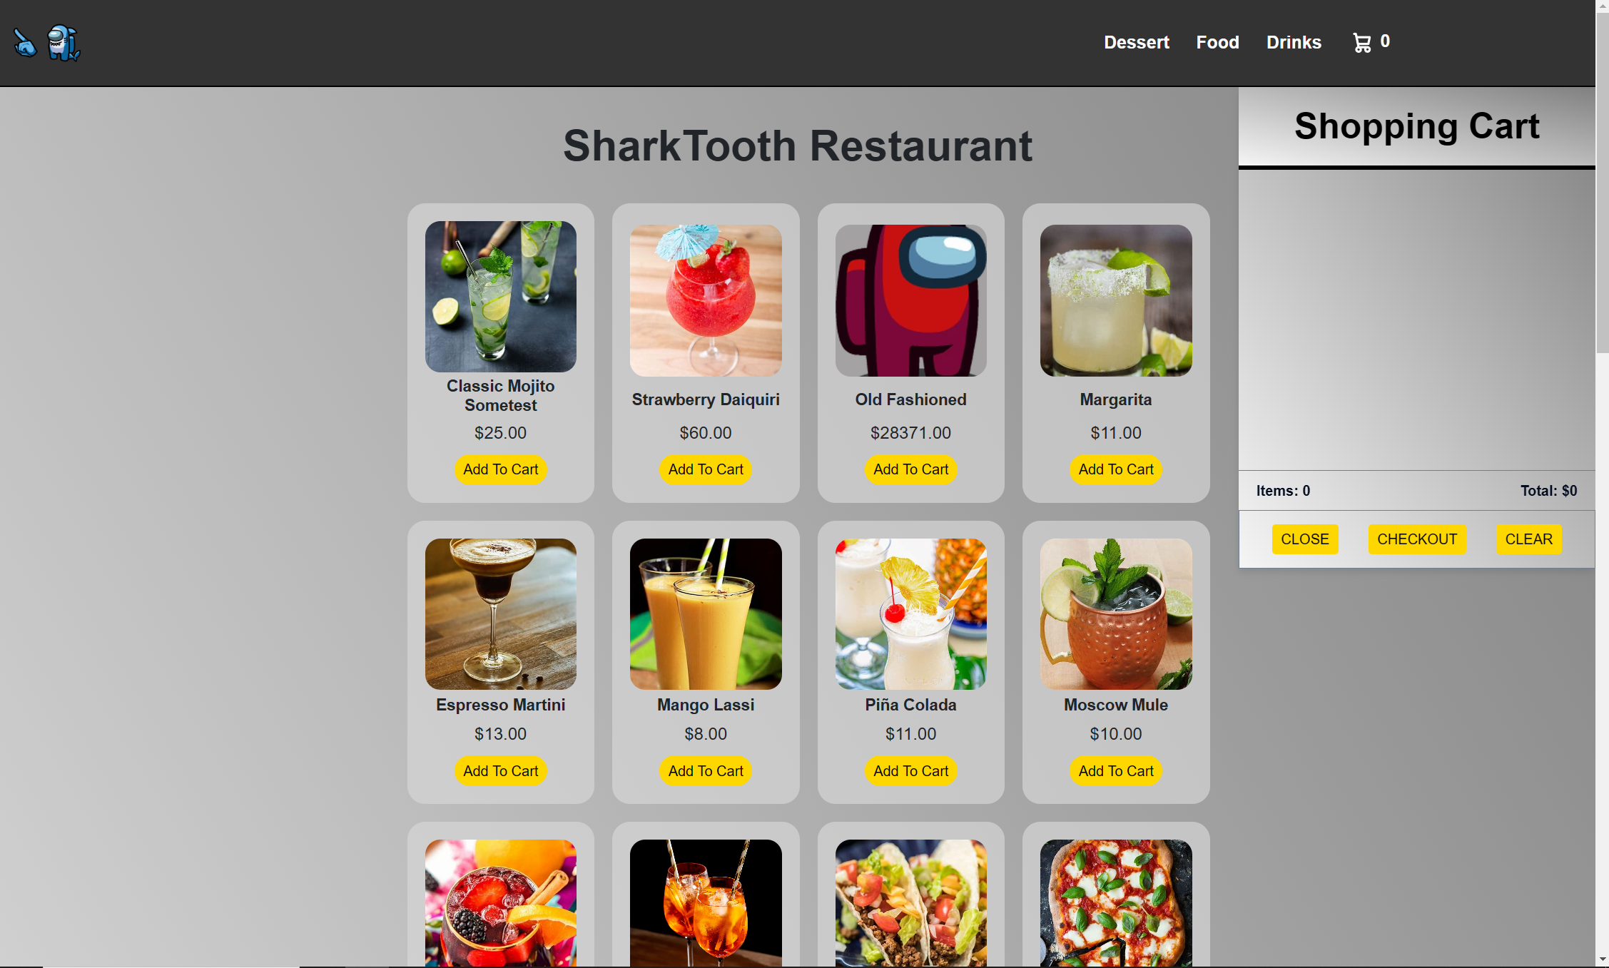
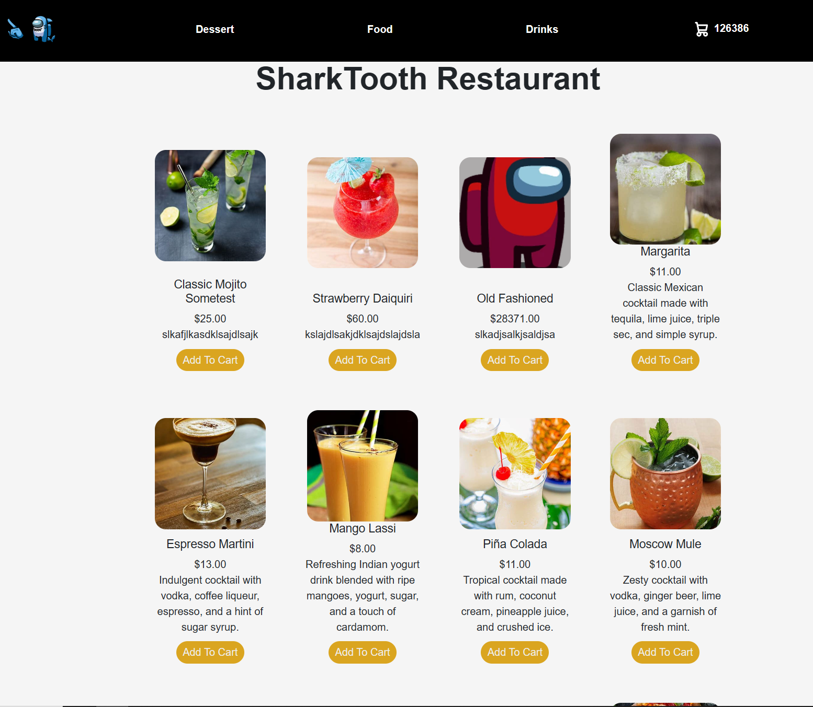
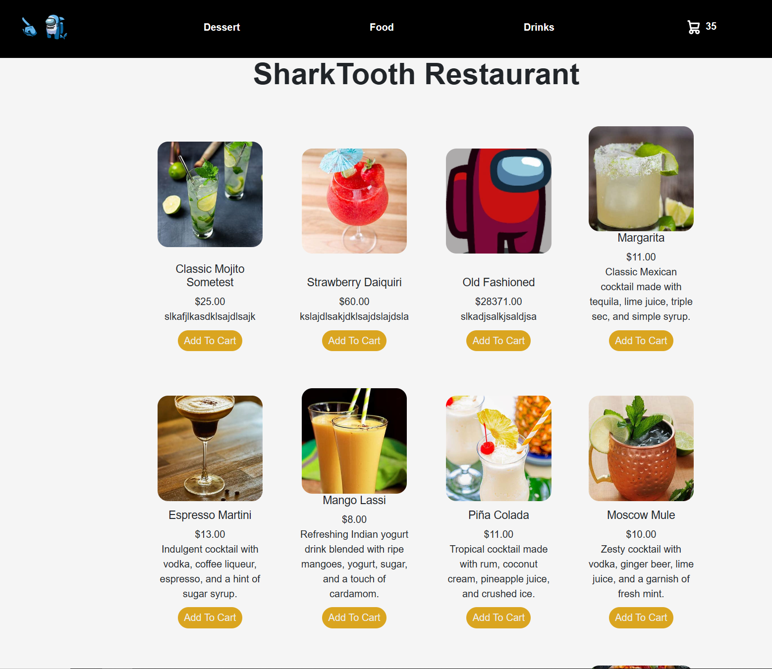
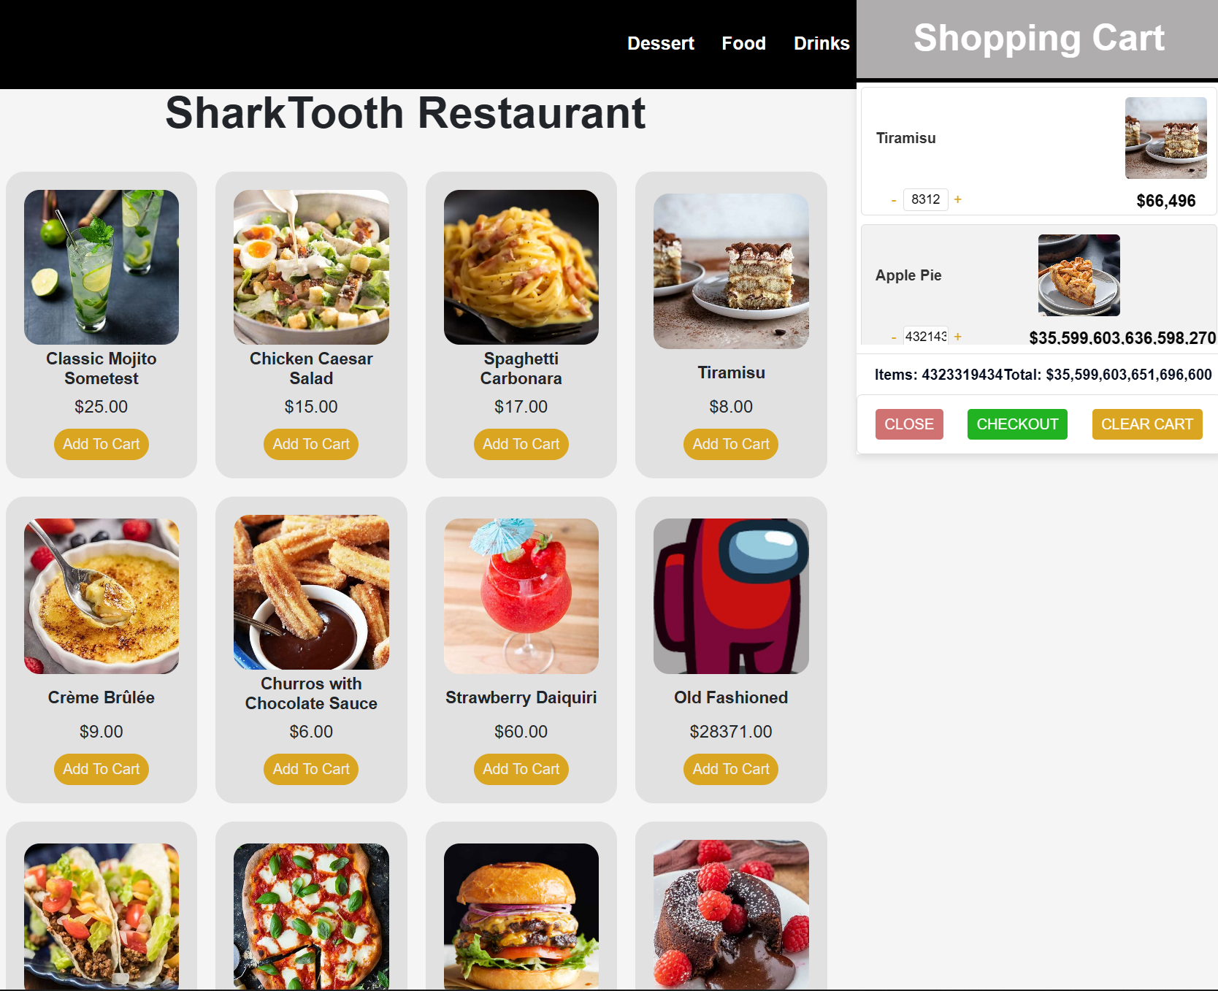
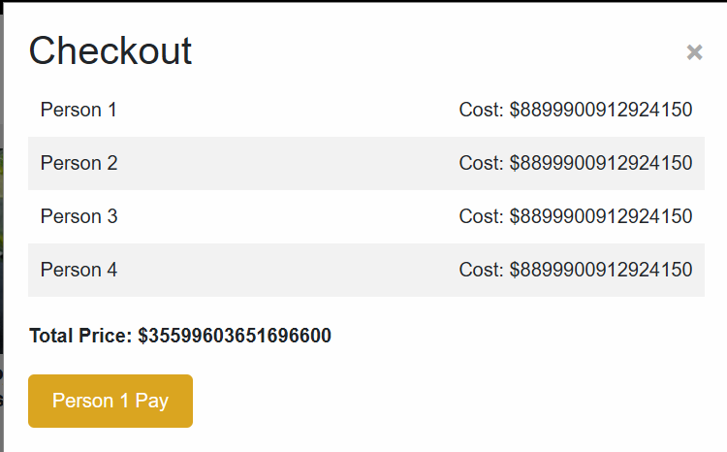
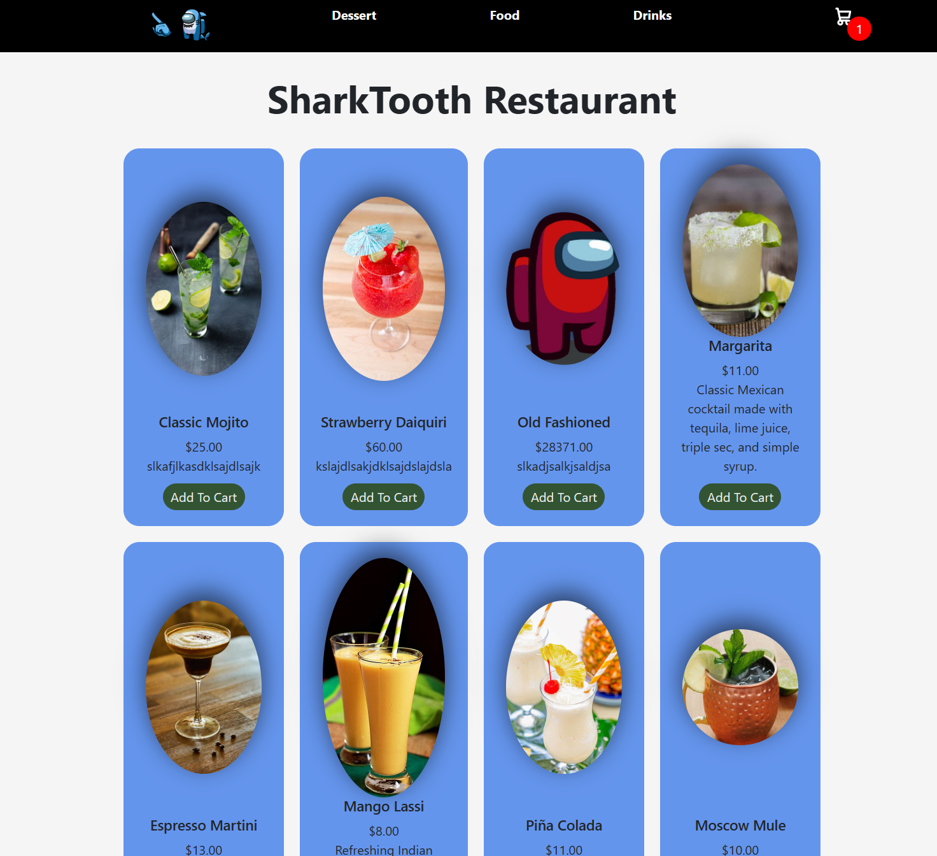
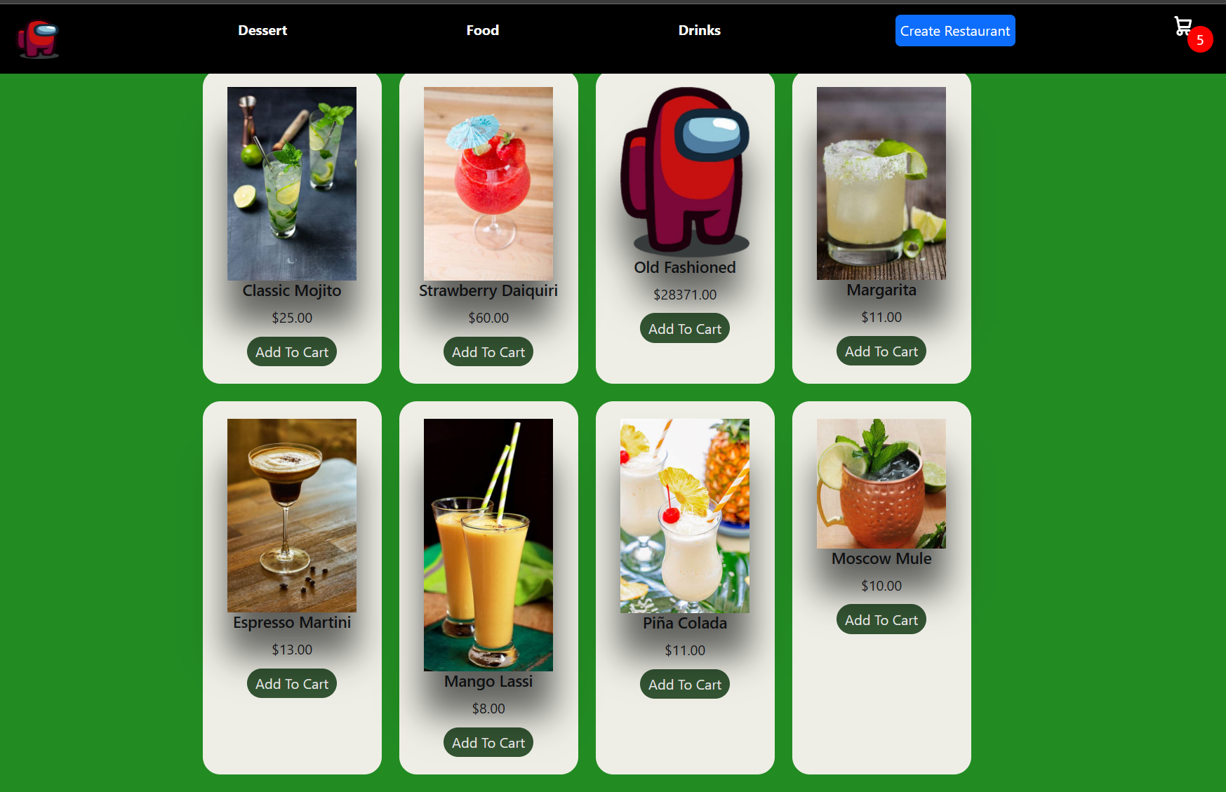
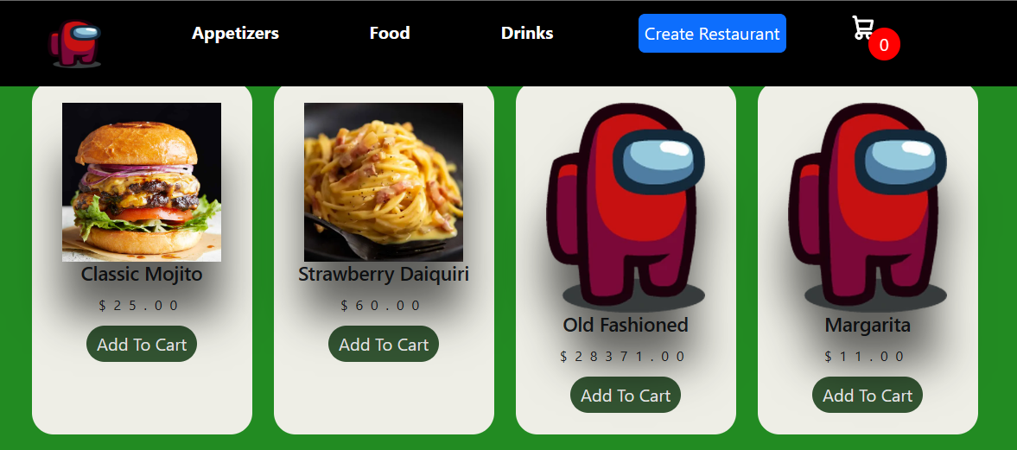
Webpage Main Menu Template

Slide 6
What Everyone is Working on - week 10/10/2024
Alexandru Cioanca
Working on updating design of the website
Front end improvements
Andrew Dutton
Working on javascript logic to fix a couple bugs
Working on cart splitting
Bug fixing and testing
Dustin Phan​
Working cart popup changes
Fixing bugs with cart buttons
Gabriel Molina​
Testing database
Connecting and connected the database to the cart
Roberto Carvalho Brigagao
Working on server creation as well as deployment
Thuan Nguyen
Looking into design aspects
Working on design and changes

